Slide 1
Modelling Camp
Earth observation
Group 4

Slide 2
longitude
latitude
start_date, end_date, source, horizon_lower, horizon_upper, aluminium_extractable, boron_extractable, calcium_extractable, carbon_organic, carbon_total, copper_extractable, electrical_conductivity, iron_extractable, magnesium_extractable, manganese_extractable, nitrogen_total, ph, phosphorus_extractable, potassium_extractable, sodium_extractable, sulphur_extractable, zinc_extractable

Slide 3
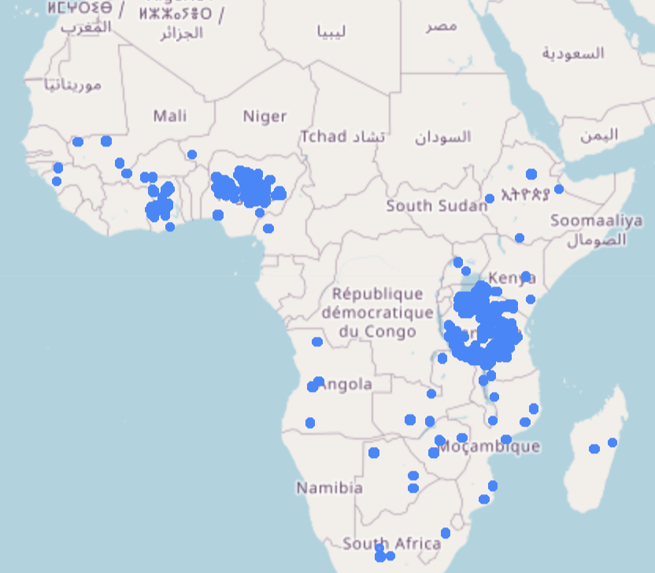
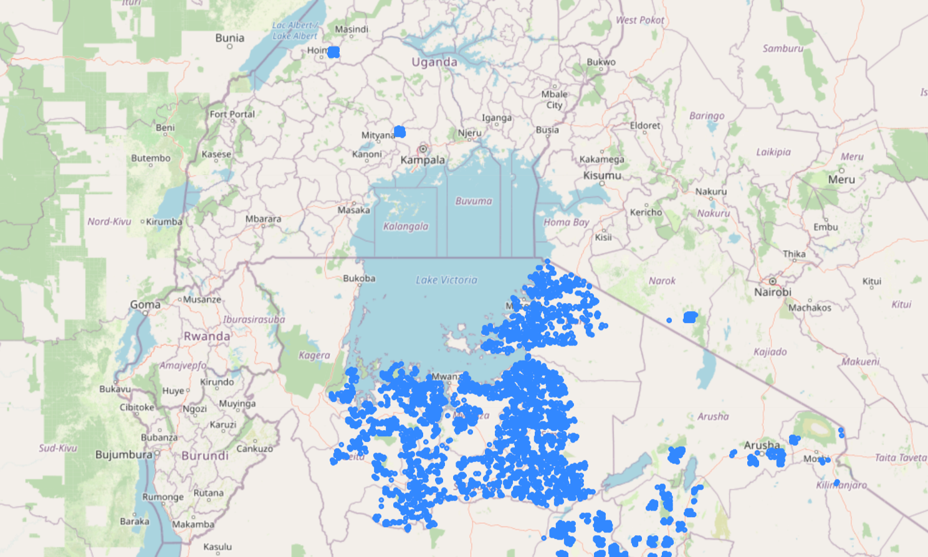

Slide 4
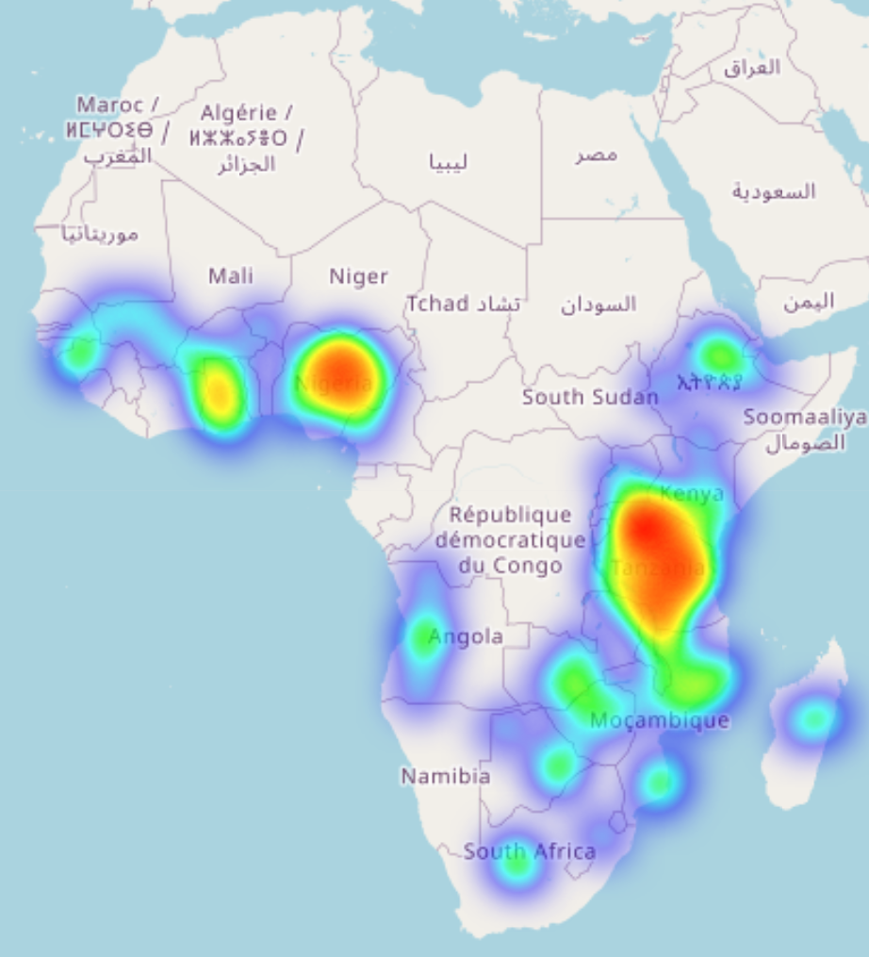
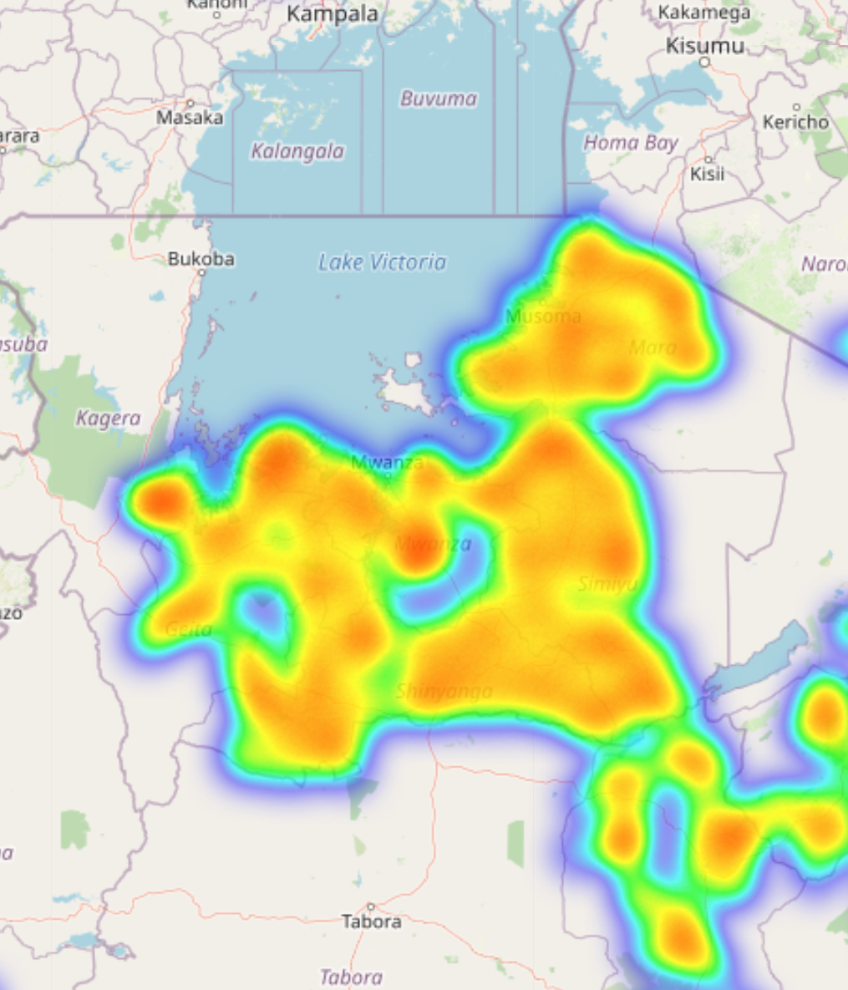

Slide 5
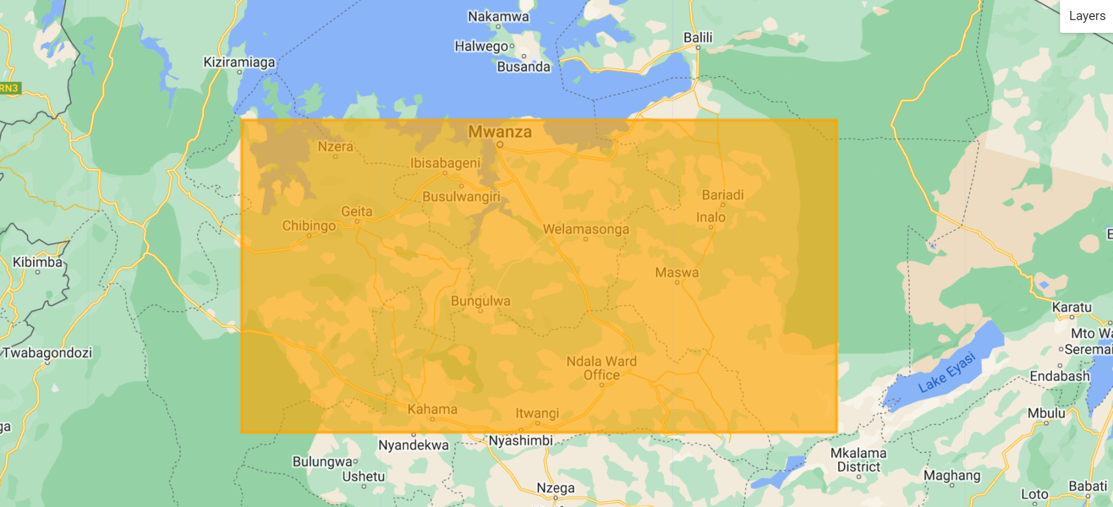

Slide 6
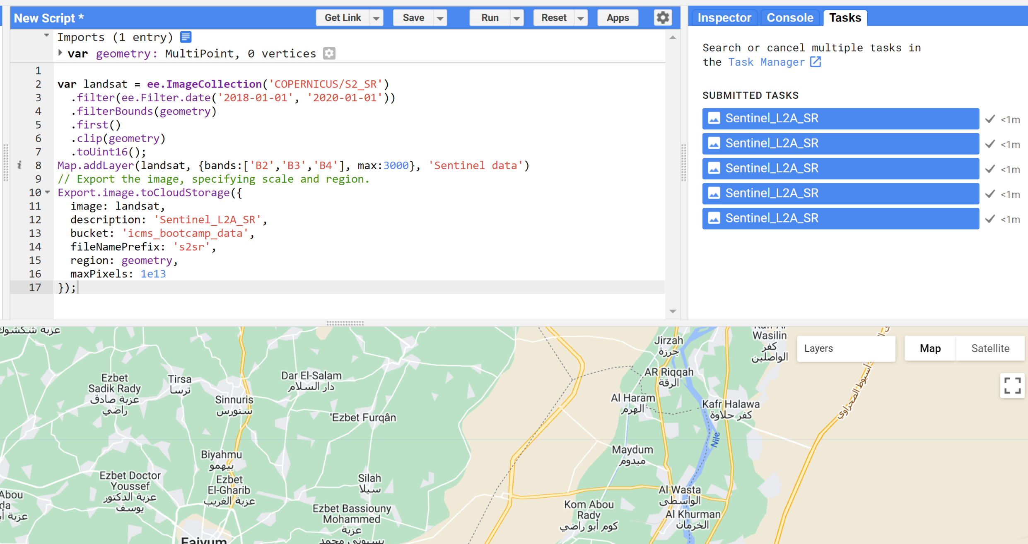

Slide 7
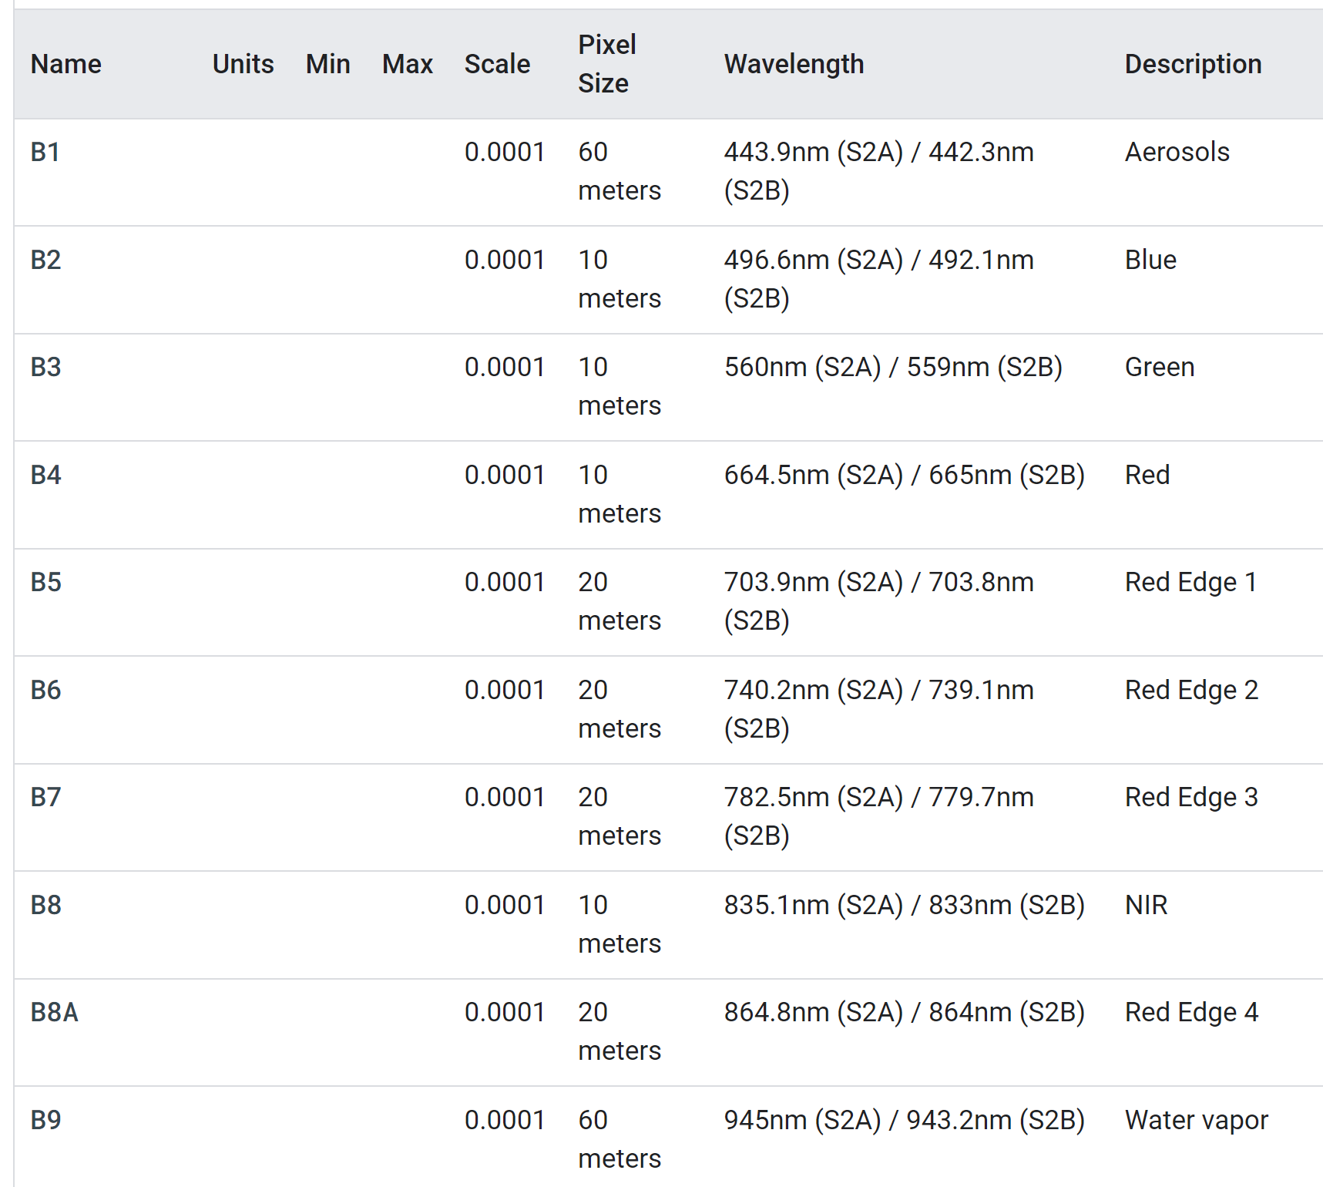
673*1275*23
168.25*318.00 km^2

Slide 8
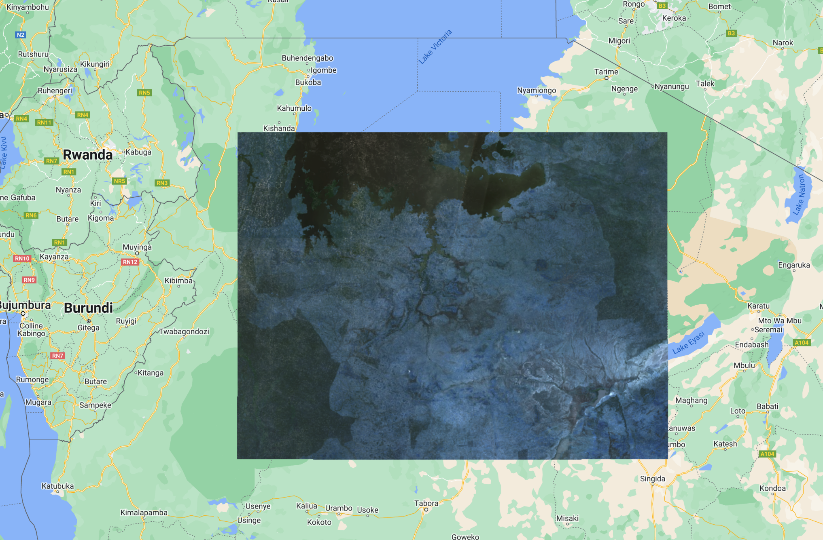

Slide 9

Future works
Process the data
Build the model
Assess the performance
Improve the performance

